Slide 1
E6156 – Topics in SW Engineering (F23) Cloud Computing Lecture 3:CDN, PaaS, DBaaS
© Donald F. Ferguson, 2023

Slide 2
API first
GraphQL
Schema first (collaboration): Ariadne, tartifilette
Code first: graphene, strawberry
Environments
https://medium.com/@ryk.kiel/graphql-and-fastapi-the-ultimate-combination-for-building-apis-with-python-f4391bf5505c

Slide 3
Lecture Start
We will start in a minute or two.

Slide 4

Contents
4 | E6156 – Topics in SW Engineering: Cloud Computing: Lecture 3 – CDN-PaaS-DBaaS © Donald F. Ferguson, 2023

Slide 5
Contents
Full Stack Web Application:
Overview
Mapping Layers to the Cloud
S3, BLOB Store and “Static” Web Content
Overview
Deployment and configuration
Platform-as-a-Service:
Concepts
Elastic beanstalk realization and details
Demo/Example

Slide 6
Full Stack Web Application
6 | E6156 – Topics in SW Engineering: Cloud Computing: Lecture 3 – CDN-PaaS-DBaaS © Donald F. Ferguson, 2023

Slide 7
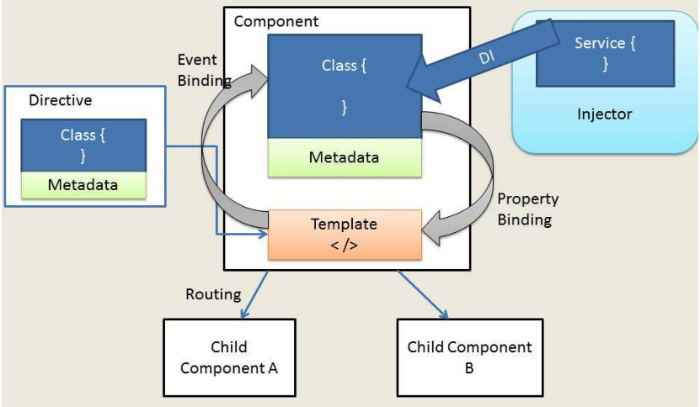
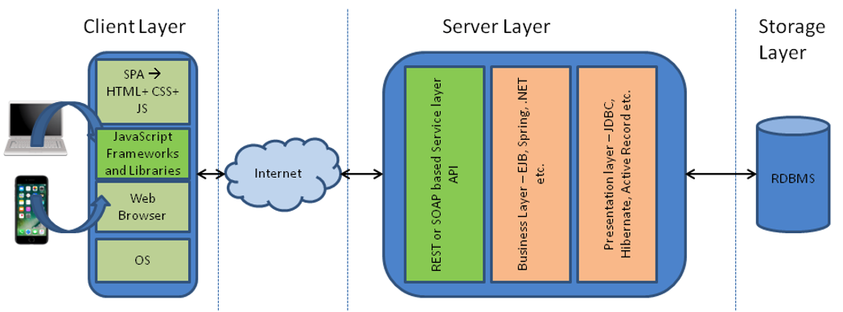
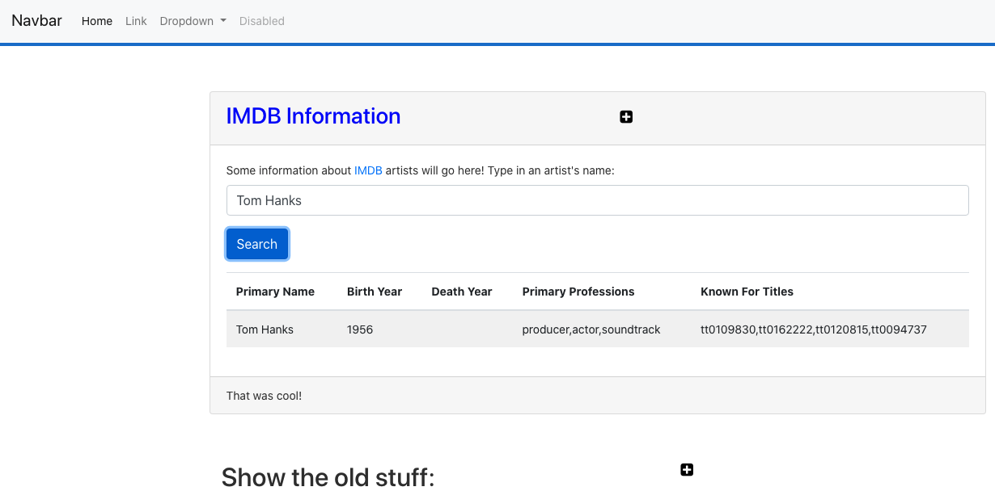
Web Application Architecture
https://dzone.com/articles/architectural-shift-in-web-applications-with-emerg
app.component
navbar.component
imdbartist.component
Template (HTML)
CSS
Component implementation
Service
Show the Code

Slide 8
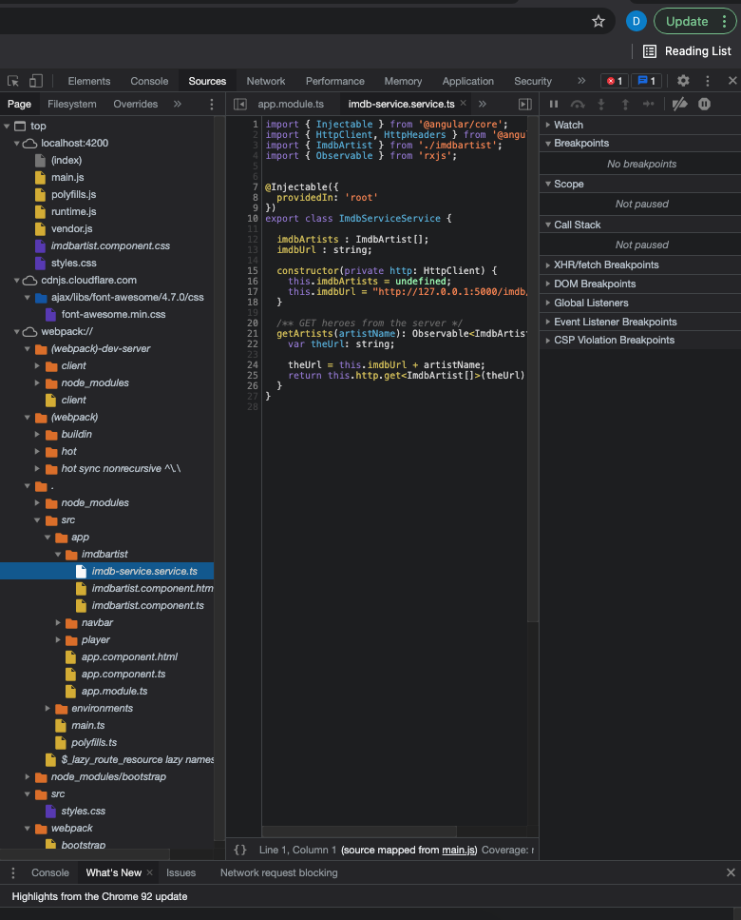
What’s in the Browser
The browser is an application that interprets the files:
HTML, CSS, etc. define the document and content.
JavaScript defines dynamic behavior.
Browser loads index.html
index.html contains links to files.
The browser loads the linked files.
These also have links, which the browser loads.
etc.
How did all of this get in the browser?
A web server delivers these files from “the file system.”
During development, Angular uses a simple, embedded web server.
“build” compiles the files into a webpack (see dist folder)
Deploying the application to the cloud →
We have seen deploying the application logic to the cloud.
What about the content?
Notes:
Show loading the demo-ui.
Show loading cnn.com.

Slide 9
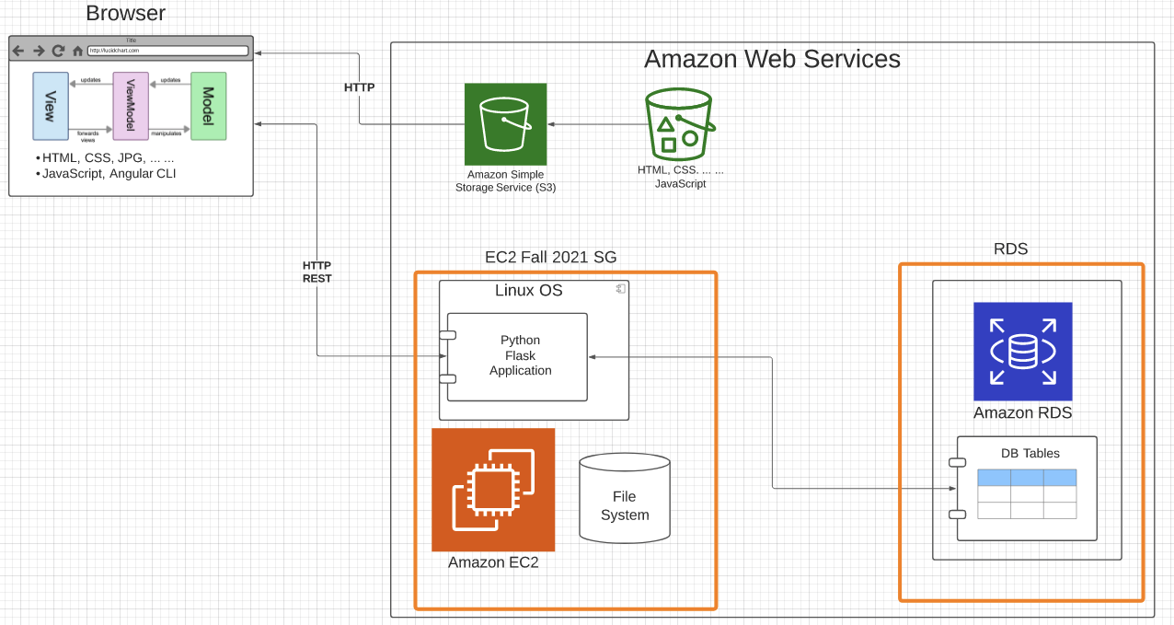
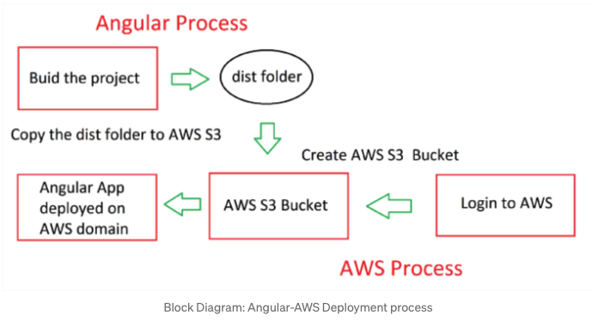
Deploy to S3
https://baljindersingh013.medium.com/angular-app-deployment-with-aws-s3-42d9008734ab
Compile the browser application (ng build -- prod)
You can test with ng serve -- prod
Generates “bundles” that contain:
JavaScript application logic.
HTML, content, ... In the app logic.
Create an S3 bucket.
Upload files from /dist folder.
Enable static web hosting.
Set access permissions.
Set index.html.
We will learn how to automate later.

Slide 10
Walkthrough
Show various S3 APIs
Show the setup of the bucket, uploading, ... ...
Explain end-to-end, including CDN.

Slide 11
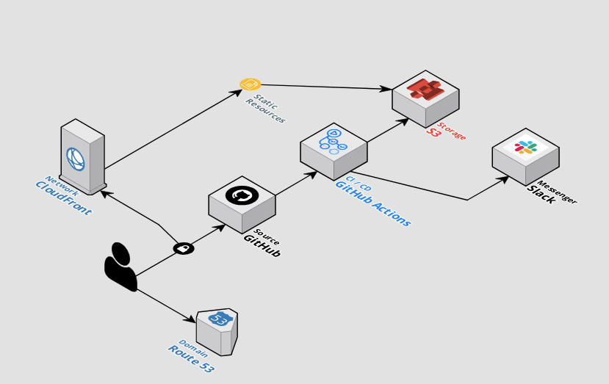
Automating Deployment
The previous slides showed manual steps to
Setup and configure.
“Deploy” the Angular application.
There are several ways to automate the process.
Automation using CLI scripts, Python scripts, ... ...
Higher layer frameworks, e.g. CloudFormation, Terraform, ... ...
GitHub actions.
... ...
https://github.com/byangular/angular-github-actions-s3-deploy
One of many tutorials and tools.

Slide 12
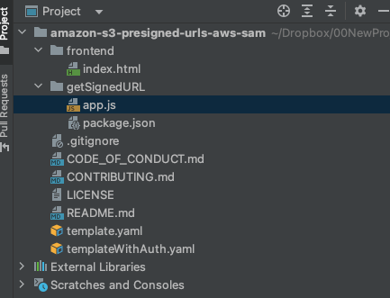
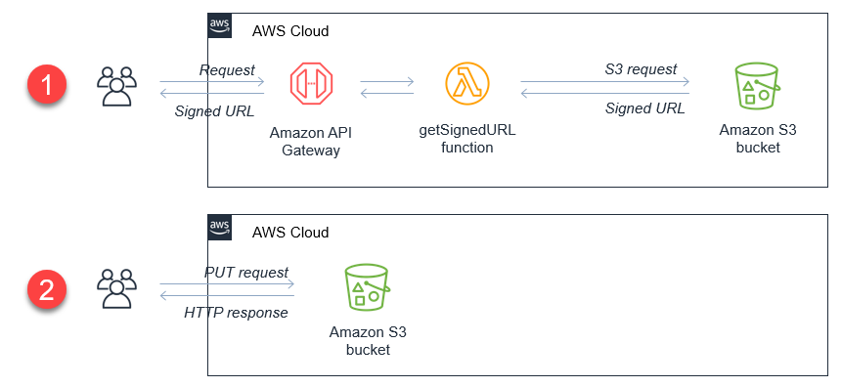
BLOB/Attachment Management
We have seen how to use S3:
Via an API from within a program.
For deploying and serving a web application and content, including images.
You can use the same technique for audio, video, etc. but most scenarios use a specialized streaming service on top of blob stores.
Microservices and web applications also use BLOB storage for upload/download of large items, e.g. files. RF Advisor used this approach on Azure.
https://aws.amazon.com/blogs/compute/uploading-to-amazon-s3-directly-from-a-web-or-mobile-application/
https://github.com/aws-samples/amazon-s3-presigned-urls-aws-sam

Slide 13

Concepts
13 | E6156 – Topics in SW Engineering: Cloud Computing: Lecture 3 – CDN-PaaS-DBaaS © Donald F. Ferguson, 2023

Slide 14
Simple Tutorial
We will follow two tutorials
https://docs.docker.com/language/python/
https://www.docker.com/blog/containerized-python-development-part-2/ (/Users/donaldferguson/Dropbox/000-NewProjects/nginx-flask-mysql)
But, the in the future, basic idea is the same as we have previously followed.
The steps:
Find an example of something cool.
Download it, set it up and run it.
Modify it and add my application code and logic.
Push it somewhere, in this case Docker Hub. (I had to use GitHub)
Deploy on the cloud. AWS gives you two or three options:
Docker on EC2
Elastic Container Service
We will start with EC2.

Slide 15
Simple Flask Example
Walk through project:
/Users/donaldferguson/Dropbox/000-NewProjects/E6156F23/python-docker
https://github.com/donald-f-ferguson/python-docker.git

Slide 16
Deploying to EC2
The simplest thing to do is to:
Tag and push your instance to Docker Hub.
Create an EC2, then install and start Docker
Pull the image, run it, remembering to expose the ports.
Test it locally with curl
Update security group to expose port.
In my case:
I have an ARM Mac.
The Amazon instances is x86
So, I clone the project and rebuild locally.
There is a way to specify the architecture in an environment variable when building. This allows build on ARM for x86 and vice-versa.

Slide 17
Microservices Continued
17 | E6156 – Topics in SW Engineering: Cloud Computing: Lecture 3 – CDN-PaaS-DBaaS © Donald F. Ferguson, 2023

Slide 18
Introduction to PaaS Elastic Beanstalk
18 | E6156 – Topics in SW Engineering: Cloud Computing: Lecture 2 – Microservices, REST, Containers, PaaS, S3 © Donald F. Ferguson, 2021

Slide 19
Platform-as-a-Service
” Platform as a service (PaaS) is an enabler for software development where a third-party service provider delivers a platform to customers so they can develop, run, and manage software applications without the need to build and maintain the underlying infrastructure themselves.” (https://www.infoworld.com/article/3223434/what-is-paas-a-simpler-way-to-build-software-applications.html)
“Platform as a service (PaaS) is a complete development and deployment environment in the cloud, with resources that enable you to deliver everything from simple cloud-based apps to sophisticated, cloud-enabled enterprise applications. ... ... PaaS allows you to avoid the expense and complexity of buying and managing software licenses, the underlying application infrastructure and middleware, container orchestrators such as Kubernetes, or the development tools and other resources. You manage the applications and services you develop, and the cloud service provider typically manages everything else. (https://azure.microsoft.com/en-us/overview/what-is-paas/)

Slide 20
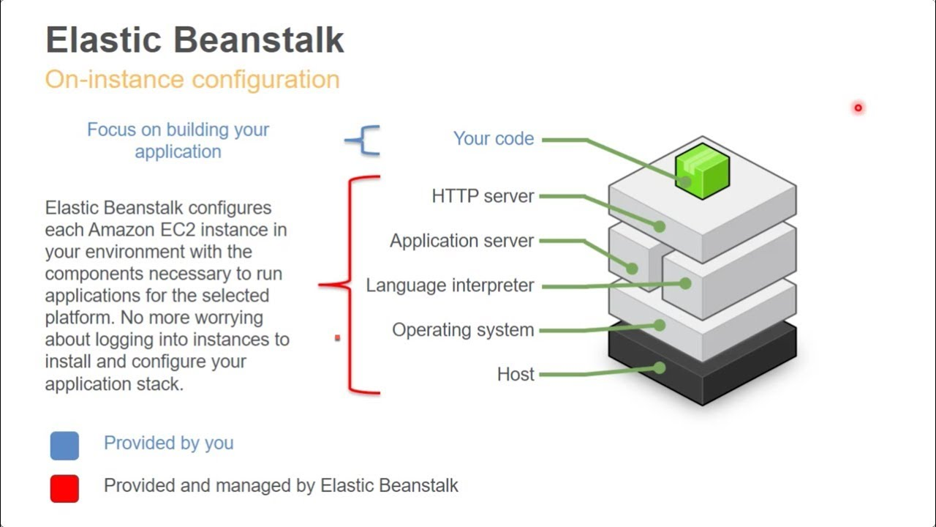
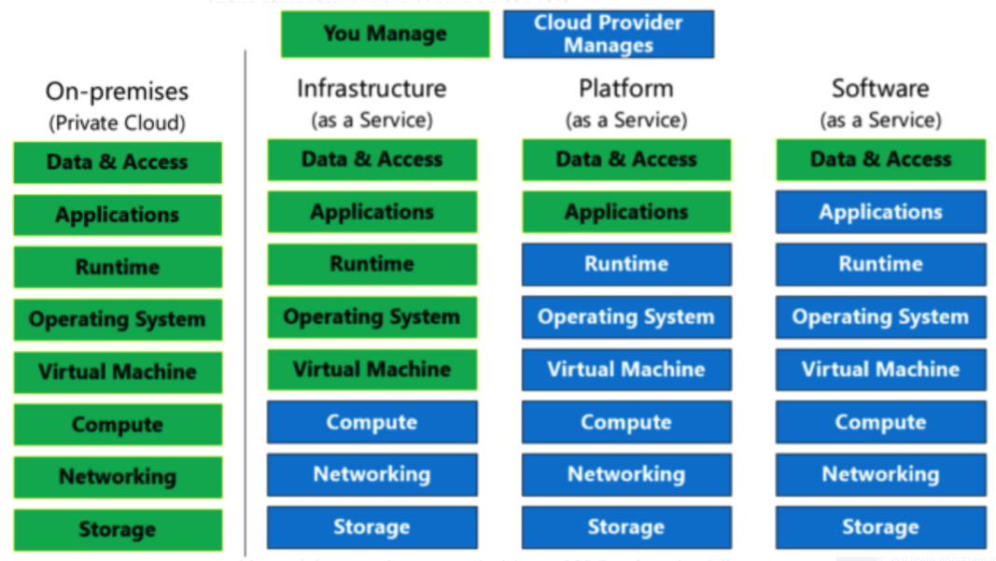
Platform-as-a-Service
Simplistically, PaaS adds two additional layers on top of IaaS:
Runtime means the language environment, libraries, etc. your application needs. For example, in our case this will mean a predefined and configured Flask environment.
“Middleware is a type of computer software that provides services to software applications beyond those available from the operating system.” (https://en.wikipedia.org/wiki/Middleware)
Basically, you do not have to build an application execution environment by installing libraries, services, ... You application “goes into a premade environment.”
Less flexible and customizable than IaaS but can be more productive to use for application scenarios.

Slide 21
Clarifying PaaS
This is a little hard to understand until you have done it a few times.
IaaS basically stops at the operating system layer. You are responsible for everything else your application code needs:
Database
Logging Service
... ...
PaaS provides a prebuilt environment with “your code goes here.”
The easiest way to see the difference is
You are using EC2 (or will be).
We will use a PaaS (Elastic Beanstalk) And you will get a feel for the differences.
So, let’s do this.

Slide 22
Start with Elastic Beanstalk
There are several reasonably good tutorials on using EB and Flask
https://docs.aws.amazon.com/elasticbeanstalk/latest/dg/create-deploy-python-flask.html
https://medium.com/analytics-vidhya/deploying-a-flask-app-to-aws-elastic-beanstalk-f320033fda3c
AWS and technology evolve. So, sometimes you have to tinker with them.
The first time you deploy, it can be error prone. But after you succeed, modifying or deploying new applications is “rinse and repeat.”
I normally just:
Create an environment with the sample application.
Download the sample and un-compress.
Modify the application to add functions.
Upload a new version.
There are a couple of issues:
Make start with a new environment and add just the packages you need.
If you add packages, you must use pip freeze > requirements.txt.
Zip acts weird, especially on Mac.
Do not zip the folder. Go inside the folder and zip just the contents you need.
On Mac: zip -r -X Archive.zip *
Note: Walk through EB console and development process.
Show sample from my GitHub repo.

Slide 23
Elastic Beanstalk
Set up environment.
Add some code.
Reupload.
Explain how this works in the long term.

Slide 24
API First Design
24 | E6156 – Topics in SW Engineering: Cloud Computing: Lecture 2 – Microservices, REST, Containers, PaaS, S3 © Donald F. Ferguson, 2021

Slide 25
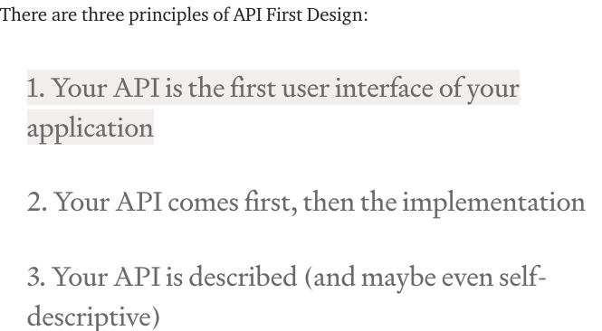
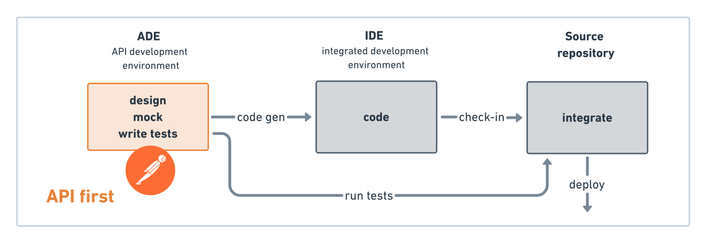
API First Design
There used to be two approaches to application development:
Data First: Define your datamodel and then implement functions/APIs.
UX First: Define and mockup the UI. Test with users. Implement functions.
Cloud Native Microservices often follow API First.
Define APIs.
Implement mockups, simple tests, etc.
Get feedback from potential users and partners.
Deploy and document,
(https://medium.com/adobetech/three-principles-of-api-first-design-fa6666d9f694)
(https://medium.com/better-practices/api-first-software-development-for-modern-organizations-fdbfba9a66d3)

Slide 26
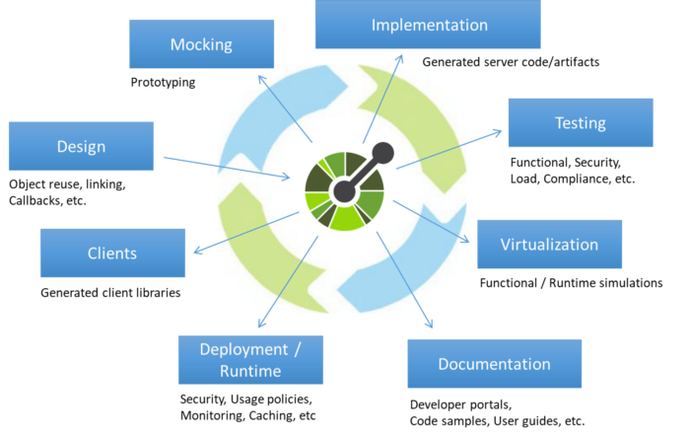
Open API
“The OpenAPI Initiative (OAI) was created by a consortium of forward-looking industry experts who recognize the immense value of standardizing on how APIs are described. As an open governance structure under the Linux Foundation, the OAI is focused on creating, evolving and promoting a vendor neutral description format.” (https://www.openapis.org/about)
There is an interactive “map” that explains the API concepts (http://openapi-map.apihandyman.io/)
I (sometimes) use:
SwaggerHub
Swagger Code Generation
To produce implementation templates from specifications.
Demo the project. (https://github.com/donald-f-ferguson/f21-demo-swagger)
Show SwaggerHub.

Slide 27
Demo Open API (Swagger Hub)
There are two approaches to defining APIs:
Build Open API definition → Code generation tools.
Start with source code and add “annotations,” e.g. https://flask-rest-api.readthedocs.io/en/stable/openapi.html
Simple example ... ... https://app.swaggerhub.com/apis/donff2/F21User/1.0.0
Demo f21-demo-swagger
http://localhost:8080/donff2/F21User/1.0.0/ui/

Slide 28
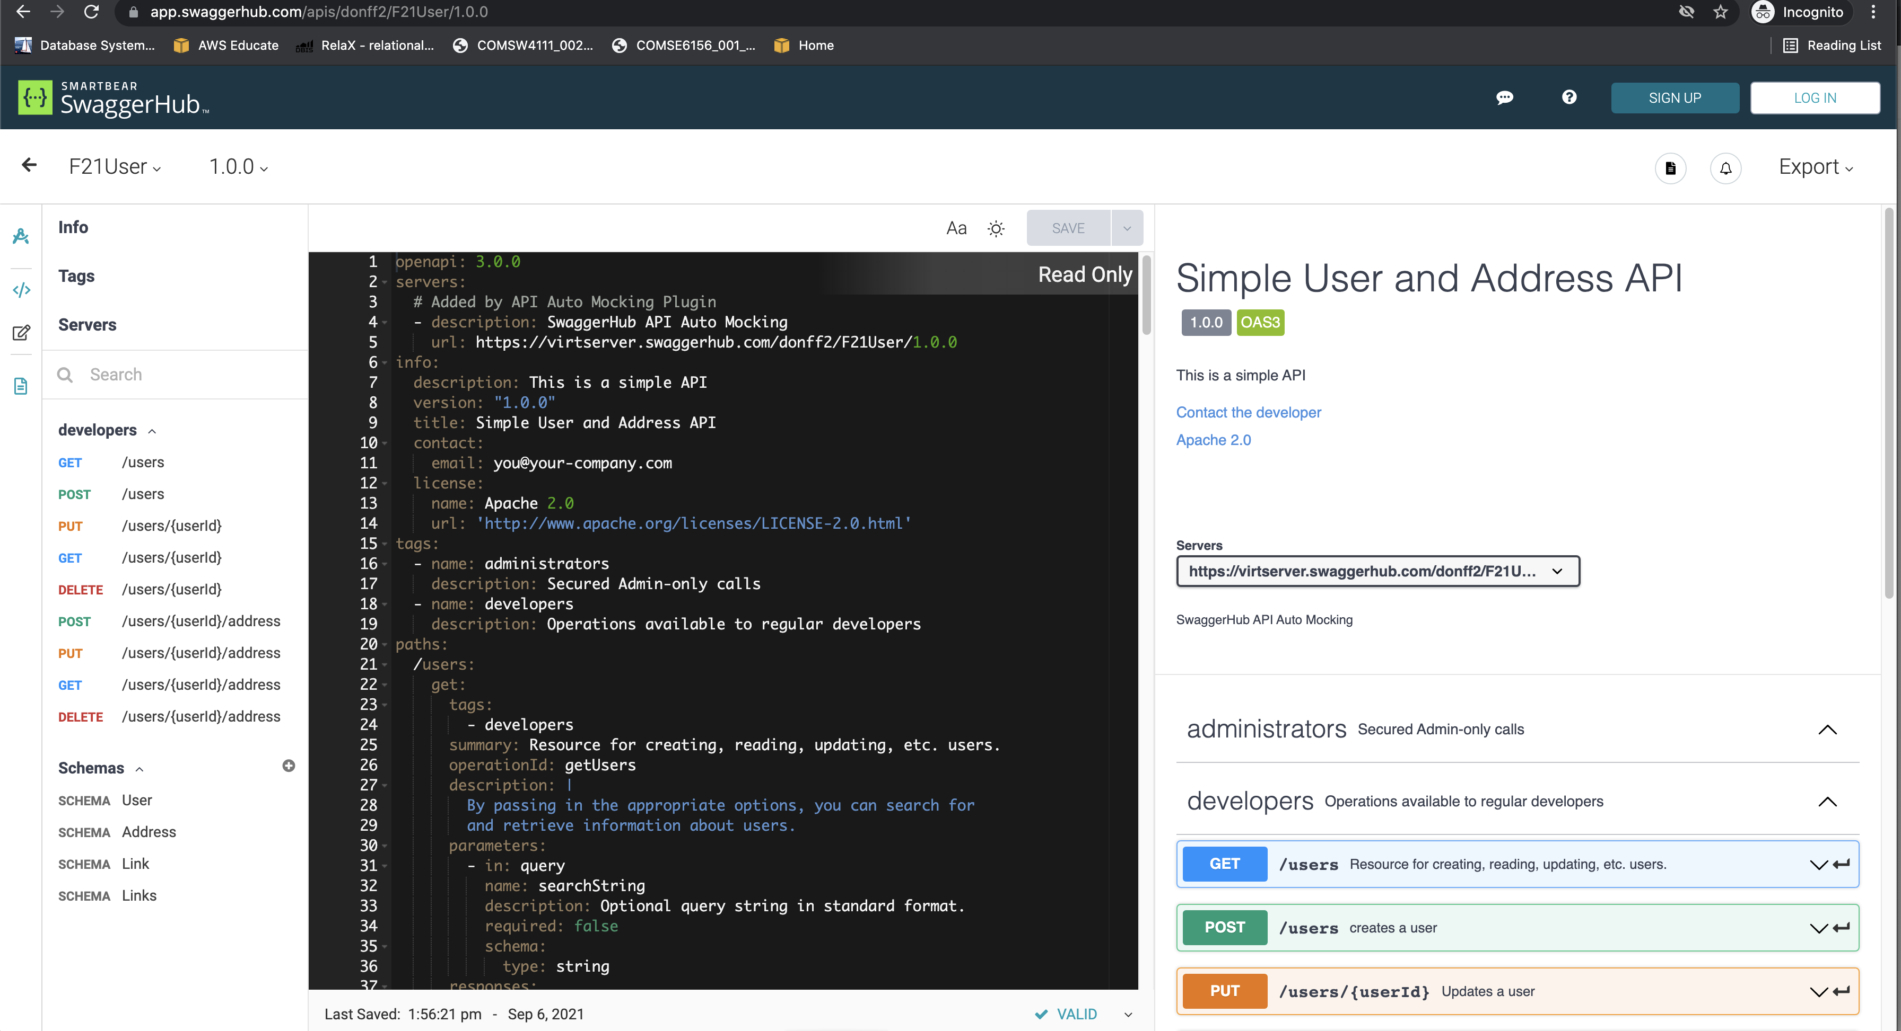
Example

Slide 29
Project – Sprint 1 (Note: Show Trello, Agile, etc).
29 | E6156 – Topics in SW Engineering: Cloud Computing: Lecture 2 – Microservices, REST, Containers, PaaS, S3 © Donald F. Ferguson, 2021

Slide 30
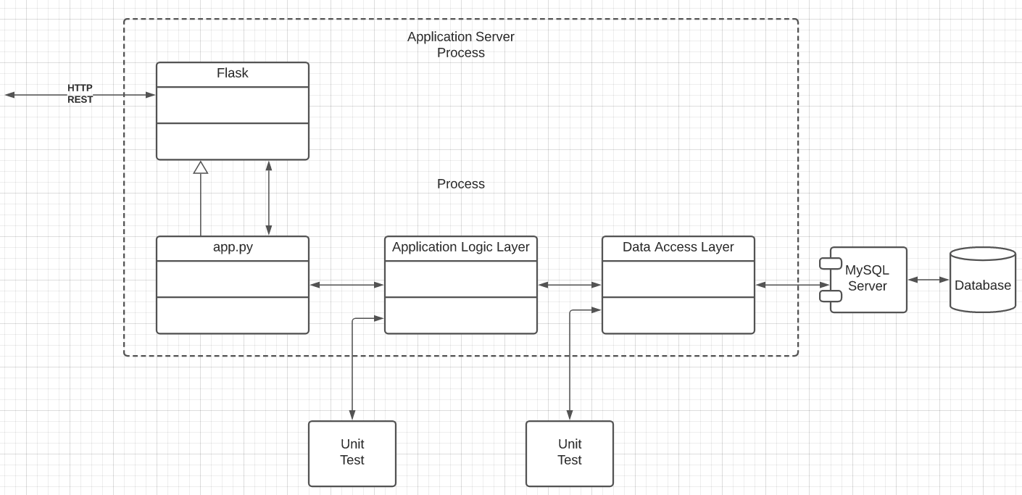
Specification (TBD)
Build microservices:
Users, ... ...
Deploy users on Use two separate RDS instances.
Implement a layered architecture:
Data objects for access DBs.
Application logic in app services.
Routing in app.py
Implement paths:
/users
/users/{id}
/users/{id}address
/addresses
/addresses/{addressId}
/addresses/{addressId}/users
... ...
Do a very simple UI and deploy on S3.

Slide 31
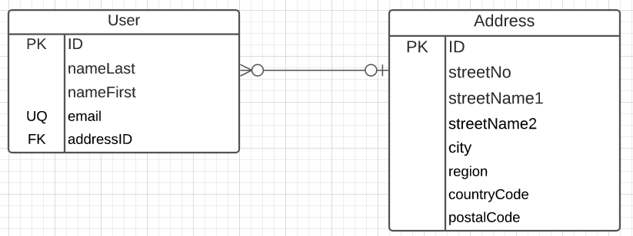
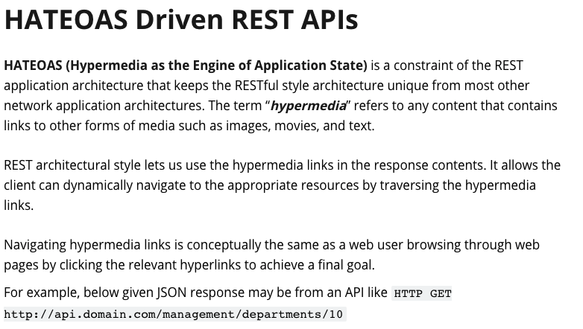
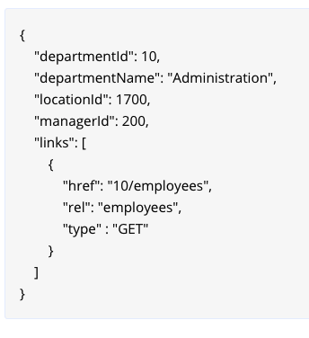
Implement Linked Data
A user has 0 or 1 addresses.
Several people make have the same address.
IDs must be unique and service generated.
Country code must come from a valid list of country codes.
City cannot contain numbers.
Email must have valid format:
Contain “@”
End in one of:
.edu
.com
.org
.mil
Only the following may be NULL
nameFirst
streetName2
https://restfulapi.net/hateoas/

